Slide 1
Programming Languages Overview

Slide 2
What is a programming language?
Computer code (or scripts) is instructions written to control the computer.
Every game, app, web page, robot etc. was written by a programmer in a language.
Some language examples: Java, JavaScript, C, C++, C#, Objective-C, Swift, Visual Basic, Python, Ruby, PHP, Perl, FORTRAN, Pascal, COBOL, mumps, ActionScript, Ada, Smalltalk, Lua

Slide 3
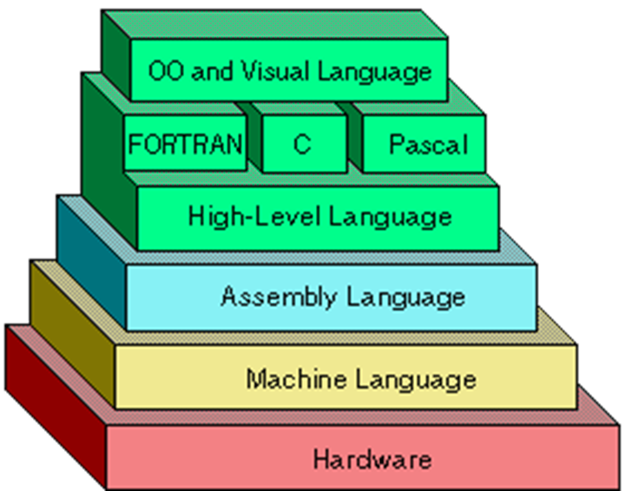
Layers of Programming

Slide 4
1. Machine code
The earliest form of programming.
The lowest level of programming.
Unreadable by humans
Binary example
0010 0100 0110 1101 1111

Slide 5
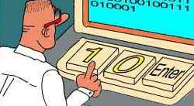
Real Programmers Code in Machine Language

Slide 6
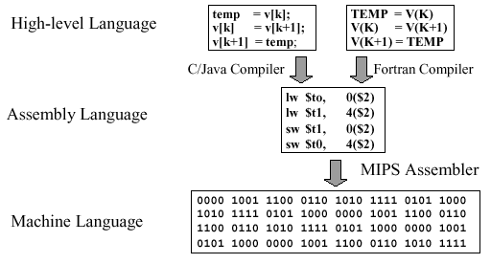

Slide 7
2. Assembly Language
One step above machine code
Requires an “assembler” to interpret the instructions so the CPU can follow the steps.

Slide 8
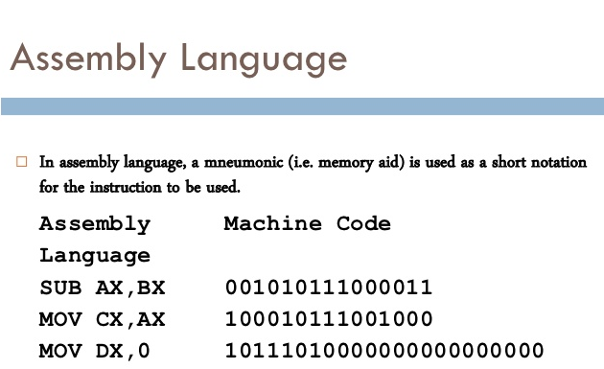

Slide 9
3. Compiled Code
A compiler translates the programmer’s script into binary instructions.
Developed by IBM in 1956 computer programs became human readable with FORTRAN (FORmula TRANslator), the first high level computer language.
C, C++, Objective-C, COBOL, Visual Basic are some common compiled languages.

Slide 10
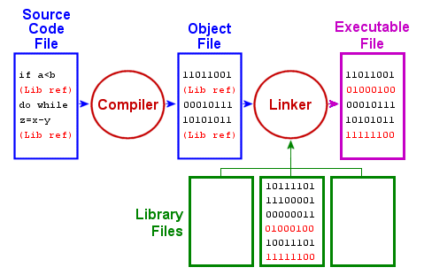
Compile and Link Process

Slide 11
4. Bytecode
Java is the most popular language that compiles to bytecodes, instructions that can be run on multiple platforms.
Source code is compiled into a format that runs on the Java Virtual Machine (JVM), a program written specifically for the hardware type.
The same source code can be run on different platforms – different hardware and operating systems – without being re-written.
Java, Python, Ruby all use bytecode compiling.

Slide 12
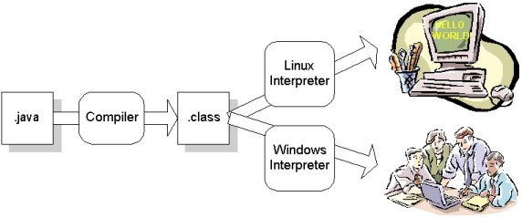
Java bytecode running on two different operating systems…
Source code
Compiled bytecode

Slide 13
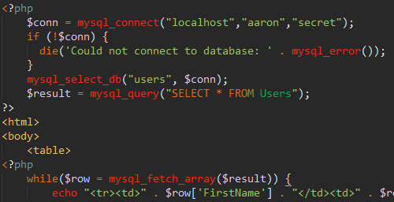
5. Interpreted Languages
Interpreted code is translated at run-time.
No compiling necessary ahead of time.
Cross-platform. Runs on a variety of operating systems and hardware.
Slow execution
PHP, Perl,
JavaScript

Slide 14
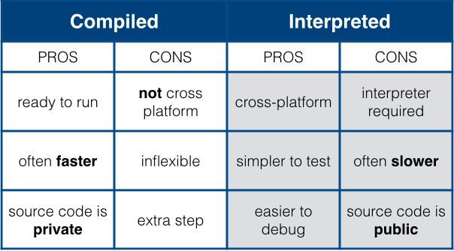
Compare the two types of code

Slide 15
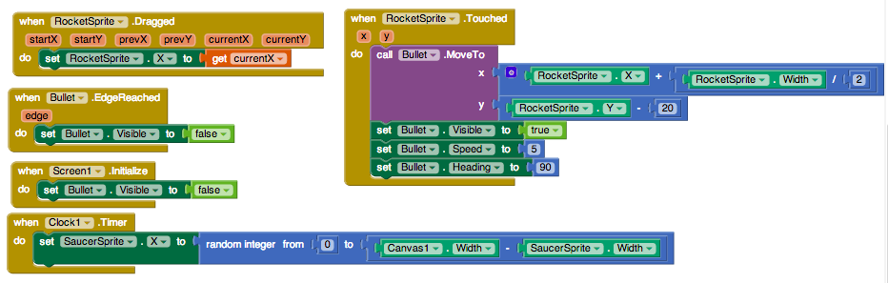
6. Visual Programming
Drag and drop blocks
Avoids syntax errors
Useful for learning how to program even if you don’t know the language commands yet.
Compiles into traditional written languages such as Java
Lego Mindstorm, App Inventor, Scratch

Slide 16
Common Markup Formats
A markup language is not an executed programming language but follows structured rules similar to computer programs.
HTML/CSS – Hypertext Markup Language and Cascading Style Sheets work together as the text formatting languages of all web pages.
SQL – Structured Query Language. Used to load, save and sort information in databases.
XML – Extensible Markup Language. Used to transfer data between apps.
JSON – JavaScript Object Notation. Like XML, it is used to transfer data.

Slide 17
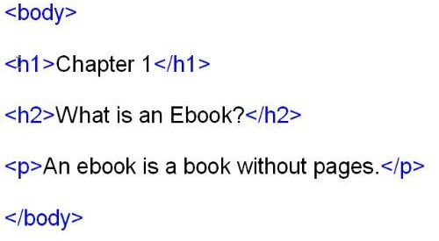
HTML example

Slide 18
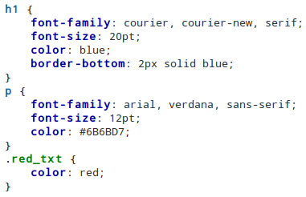
CSS Example

Slide 19
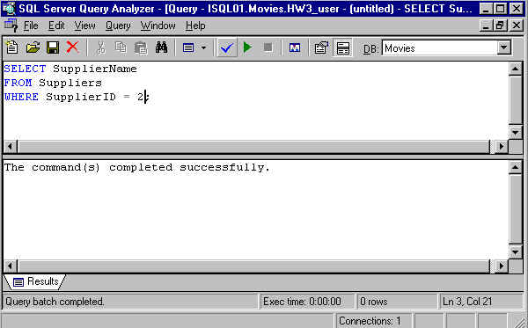
SQL Example

Slide 20
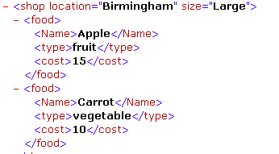
XML example

Slide 21
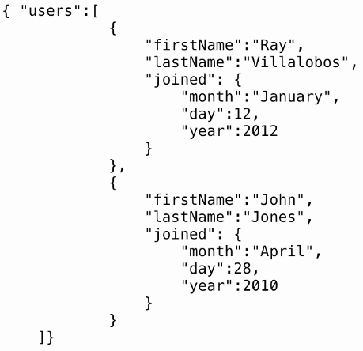
JSON example

Slide 22
What language is the best?
There is no “best” language for everything. Web, mobile, desktop, servers, database, embedded all have their preferred language.
The main elements of computer science are found in all languages (loops, if-else, variables, strings, functions, arrays etc.)
Java, JavaScript, C#, C++ and Python are popular general purpose languages.
HTML/CSS, JavaScript are popular web page development tools.
SQL and PHP are popular back-end web server tools.

Slide 23
Languages used in this class
Visual Basic
SQL
JavaScript
Gaming systems Construct 2, Unity
Possibly Java for Android

Slide 24
What is the most common language in use today?
http://www.codeconquest.com/what-is-coding/common-programming-languages/
http://langpop.com/

